Slide 1

Optimization Algorithms
Learning Objectives:
Apply optimization methods such as (Stochastic) Gradient Descent, Momentum, RMSProp and Adam
Use random minibatches to accelerate convergence and improve optimization
Describe the benefits of learning rate decay and apply it to your optimization

Slide 2
Optimization Algorithms
1 Mini-batch gradient descent
2 Understanding mini-batch gradient descent
3 Exponentially weighted averages
4 Understanding exponentially weighted averages
5 Bias correction in exponentially weighted average
6 Gradient descent with momentum
7 RMSprop
8 Adam optimization algorithm
9 Learning rate decay
10 The problem of local optima

Slide 3
Optimization Algorithms
Mini-batch gradient descent

Slide 4
Mini-batch gradient descent
In machine learning, gradient descent is an optimization technique used for computing the model parameters (coefficients and bias) for algorithms like linear regression, logistic regression, neural networks, etc. In this technique, we repeatedly iterate through the training set and update the model parameters in accordance with the gradient of the error with respect to the training set. Depending on the number of training examples considered in updating the model parameters, we have 3-types of gradient descents:
Batch Gradient Descent: Parameters are updated after computing the gradient of the error with respect to the entire training set
Stochastic Gradient Descent: Parameters are updated after computing the gradient of the error with respect to a single training example
Mini-Batch Gradient Descent: Parameters are updated after computing the gradient of the error with respect to a subset of the training set

Slide 5
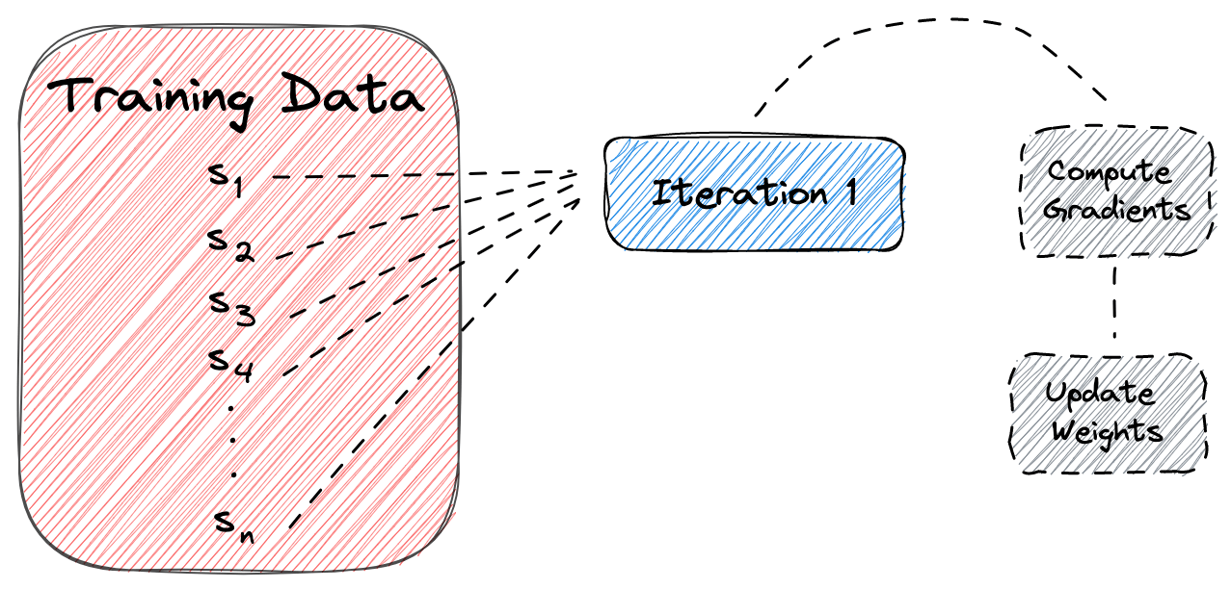
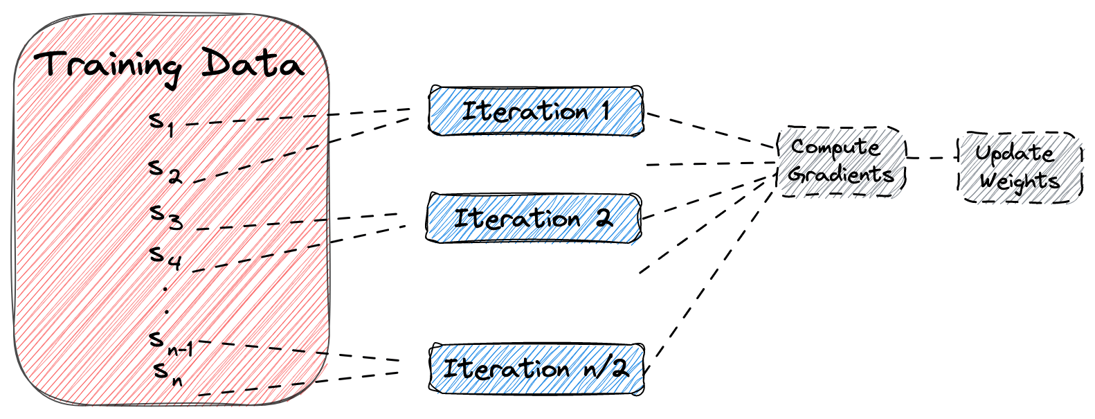
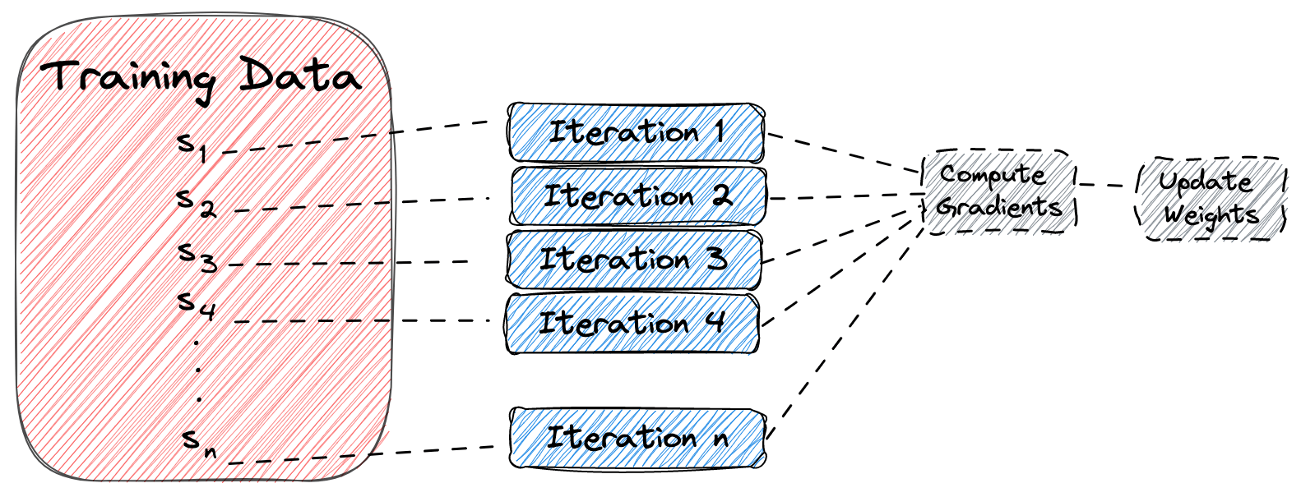
Mini-batch gradient descent
Batch Gradient Descent
Mini-Batch Gradient Descent
Stochastic Gradient Descent

Slide 6
Mini-batch gradient descent
Batch Gradient Descent | Stochastic Gradient Descent | Mini-Batch Gradient Descent
Since the entire training data is considered before taking a step in the direction of gradient, therefore it takes a lot of time for making a single update. | Since only a single training example is considered before taking a step in the direction of gradient, we are forced to loop over the training set and thus cannot exploit the speed associated with vectorizing the code. | Since a subset of training examples is considered, it can make quick updates in the model parameters and can also exploit the speed associated with vectorizing the code.
It makes smooth updates in the model parameters | It makes very noisy updates in the parameters | Depending upon the batch size, the updates can be made less noisy – greater the batch size less noisy is the update
In this lesson, we only study mini-batch gradient descent.

Slide 7
Mini-batch gradient descent
An epoch means that we have passed each sample of the training set one time through the network to update the parameters. Generally, the number of epochs is a hyperparameter that defines the number of times that gradient descent will pass the entire dataset.
If we look at the previous methods, we can see that:
- In batch gradient descent, one epoch corresponds to a single iteration through the entire training dataset.
- In stochastic gradient descent, one epoch corresponds to n iterations, where n is the number of training samples.
- In mini-batch gradient descent, one epoch corresponds to n/b iterations, where b is the size of the mini-batch.
A batch is equal to the total training data used in batch gradient descent to update the network’s parameters.
A mini-batch is a subset of the training data used in each iteration of the training algorithm in mini-batch gradient descent.

Slide 8
Mini-batch gradient descent
Let’s assume that we have a dataset with n = 2000 samples, and we want to train a deep learning model using gradient descent for 10 epochs and mini-batch size b = 4:
In batch gradient descent, we’ll update the network’s parameters (using all the data) 10 times which corresponds to 1 time for each epoch.
In stochastic gradient descent, we’ll update the network’s parameters (using one sample each time) 2000*10 = 20000 times which corresponds to 2000 times for each epoch.
In mini-batch gradient descent, we’ll update the network’s parameters (using b = 4 samples each time) (2000/4)*10 = 5000 times that corresponds to 2000/4 = 500 times for each epoch.

Slide 9
Mini-batch gradient descent
Mini-batch gradient descent accelerates deep learning training on large datasets by processing smaller subsets, or mini-batches, at a time. It employs a for loop to iterate through each mini-batch, performing forward and backward propagation to update weights and compute gradients, making the training process more efficient.
Notes:
Deep Learning works best with big data, but training on large data sets is slow, so having good optimization algorithms can help speed up the process.
Mini-batch gradient descent is a variant of gradient descent that allows the neural network to make progress even before processing the entire training set. It works by splitting up the training set into smaller, baby training sets called mini-batches, each consisting of a smaller number of training examples, such as 1,000 examples each.
To run mini-batch gradient descent on the training set, you use a for loop that goes through each mini-batch and implement one step of gradient descent using that mini-batch. Inside the for loop, you implement forward propagation on the inputs, compute the cost function, implement backpropagation to compute gradients, and then update the weights.

Slide 10
Mini-batch gradient descent
Vectorization allows you to efficiently compute on m examples. But m if is really large that can still be slow. A solution to this is only ingest a small fixed amount of examples (1000, for example) and use each one to iteratively compute the errors.
Notation:
- x^{(i)} ith example in the test set
- Z^{[l]} lth layer in the neural network
- X^{{i}} ith batch in the mini-batch test set. X^{{i}}. shape = (n_{x}, m)
Mini-Batch algorithm pseudo code:
for t = 1:No_of_batches # this is called an epoch
A^{L}, caches = forward_prop(X^{{t}}, Y^{{t}})
cost = compute_cost(A^{L}, Y^{{t}})
grads = backward_prop(A^{L}, caches)
update_parameters(grads)
The code inside an epoch should be vectorized.

Slide 11
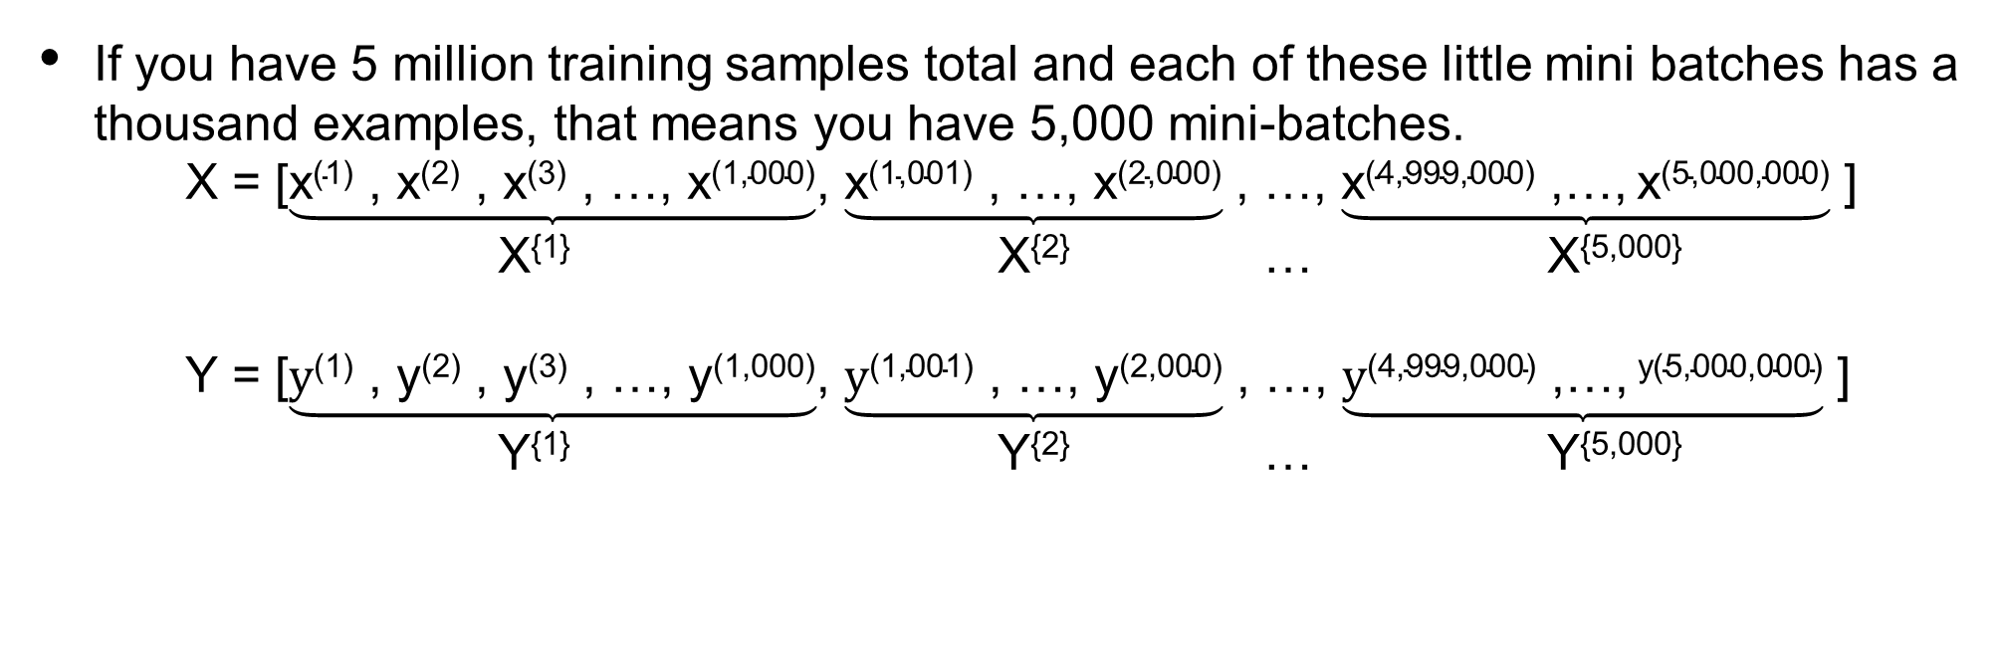
Mini-batch gradient descent
If you have 5 million training samples total and each of these little mini batches has a thousand examples, that means you have 5,000 mini-batches.
X = [$\underbrace{\text{x}\text{(1)}\text{ , }\text{x}\text{(2)}\text{ , }\text{x}\text{(3)}\text{ , …, }\text{x}\text{(1,000)}}$, $\underbrace{\text{x}\text{(1}\text{,001}\text{)}\text{ , …, }\text{x}\text{(}\text{2}\text{,000)}}$ , …, $\underbrace{\text{x}\text{(4,999,000)}\text{ ,…,} \text{x}\text{(5,000,000)}}$ ]
X^{{1}} X^{{2}} … X^{{5,000}}
Y = [$\underbrace{\text{y}\text{(1)}\text{ , }\text{y}\text{(2)}\text{ , }\text{y}\text{(3)}\text{ , …, }\text{y}\text{(1,000)}}$, $\underbrace{\text{y}\text{(1,001)}\text{ , …, }\text{y}\text{(2,000)}}$ , …, $\underbrace{\text{y}\text{(4,999,000)}\text{ ,…,} \text{y}\text{(5,000,000)}}$ ]
Y^{{1}} Y^{{2}} … Y^{{5,000}}
(n_{x} , m)
(n_{x} , 1000)
(n_{x} , 1000)
(n_{x} , 1000)
(1, m)
(1 , 1000)
(1 , 1000)
(1 , 1000)

Slide 12
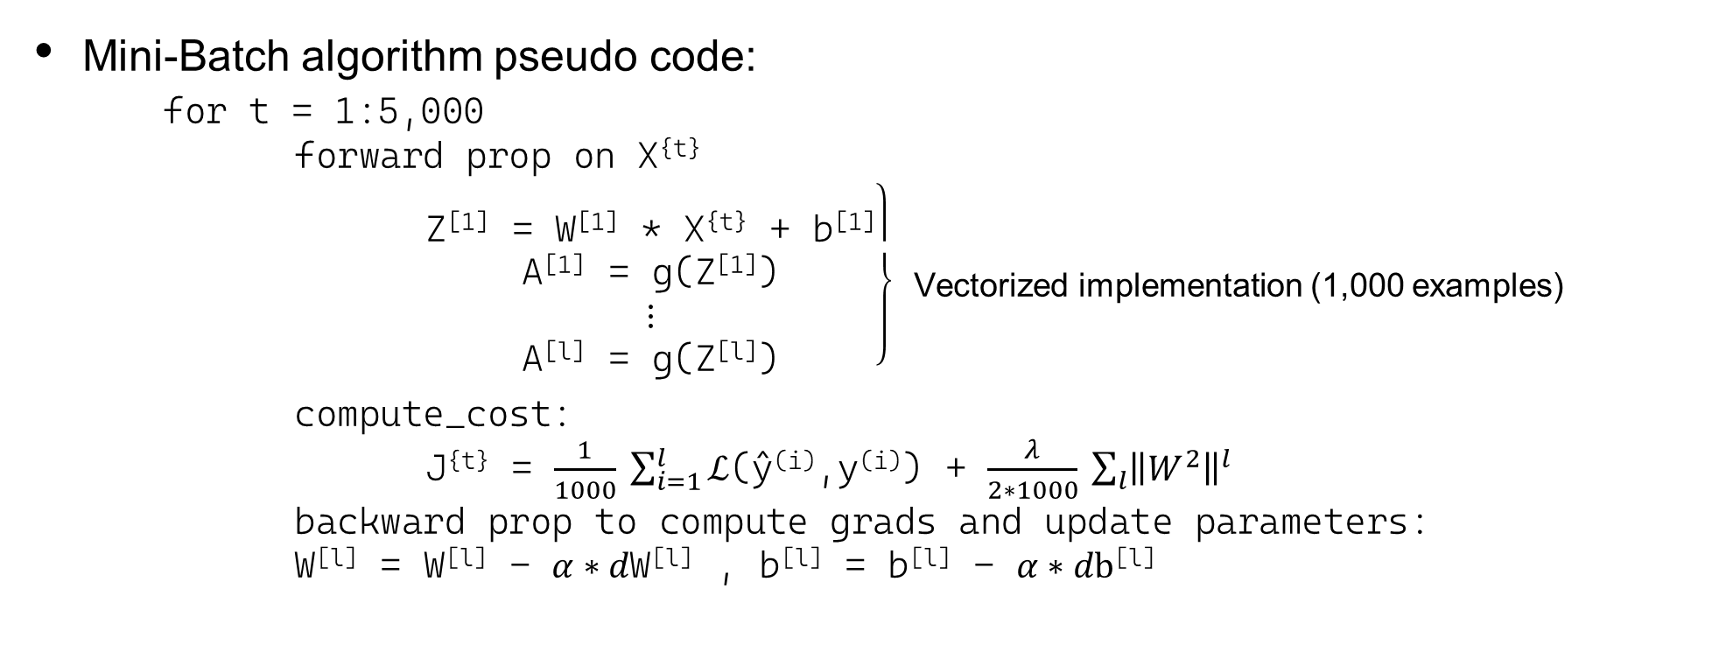
Mini-batch gradient descent
Mini-Batch algorithm pseudo code:
for t = 1:5,000
forward prop on X^{{t}}
$\left.\begin{aligned} \\ \text{Z}\text{[}\text{1}\text{]}\text{ = }\text{W}\text{[}\text{1}\text{]}\text{ ∗ }\text{X}\text{\{}\text{t}\text{\} + }\text{b}\text{[1]} \\ \text{A}\text{[1]}\text{ = }\text{g}\text{(}\text{Z}\text{[}\text{1}\text{]}\text{)} \\ ⋮ \\ \text{A}\text{[}\text{l}\text{] = }\text{g}\text{(}\text{Z}\text{[}\text{l}\text{]}\text{)}\end{aligned}\right\}$ Vectorized implementation (1,000 examples)
compute_cost:
J^{{t}} = $\frac{1}{1000} \sum_{i=1}^{l}{ℒ}$(ŷ^{(i)},y^{(i)}) + $\frac{λ}{2∗1000} \sum_{l}{{\left\|W^{2}\right\|}^{l}}$
backward prop to compute grads and update parameters:
W^{[l]} = W^{[l]} - $α∗d\text{W}\text{[}\text{l}\text{]}$ , b^{[l]} = b^{[l]} - $α∗d\text{b}\text{[}\text{l}\text{]}$

Slide 13
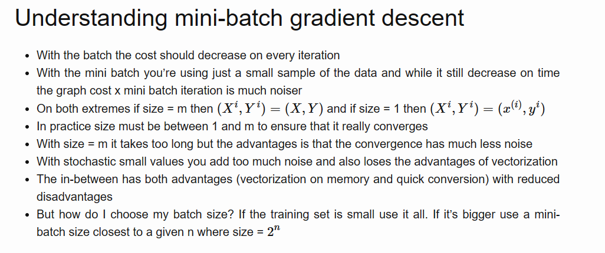

Slide 14
Optimization Algorithms
Understanding mini-batch gradient descent

Slide 15
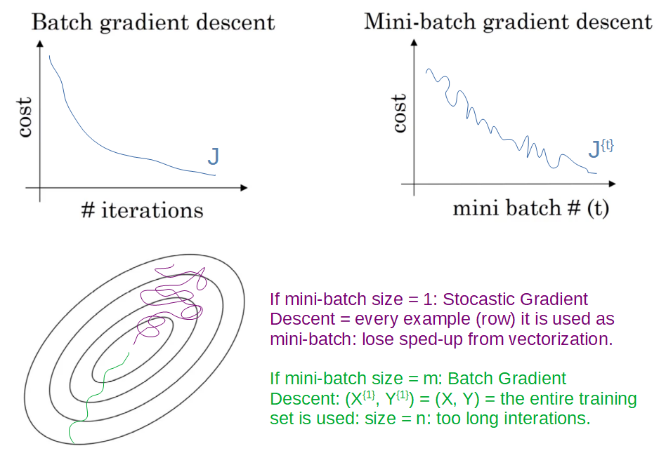
Training with mini batch gradient descent

Slide 16
Choosing your mini-batch size
Let’s see various cases:
If the mini-batch size = m:
It is a batch gradient descent where all the training examples are used in each iteration. It takes too much time per iteration.
If the mini-batch size = 1:
It is called stochastic gradient descent, where each training example is its own mini- batch. Since in every iteration we are taking just a single example, it can become extremely noisy and takes much more time to reach the global minima.
If the mini-batch size is between 1 to m:
It is mini-batch gradient descent. The size of the mini-batch should not be too large or too small.

Slide 17
Choosing your mini-batch size
Below are a few general guidelines to keep in mind while deciding the mini-batch size:
- If the training set is small, we can choose a mini-batch size of m<2000
- For a larger training set, typical mini-batch sizes are: 64, 128, 256, 512
- Make sure that the mini-batch size fits your CPU/GPU memory. If data fits in CPU/GPU, we can leverage the speed of processor cache, which significantly reduces the time required to train a model.

Slide 18
Optimization Algorithms
Exponentially weighted averages

Slide 19
Exponentially weighted averages
Exponentially weighted averages (EWAs) are a way to compute a moving average of a sequence of data points that assigns exponentially decreasing weights to the previous values in the sequence. This means that more recent data points are given more weight than older ones.
The formula for computing the exponentially weighted average is given by
V_{t} = βV_{t-1} + (1-β)θ_{t}
where β is a parameter between 0 and 1 that controls the weight given to the previous average, V_{t-1}, and the current data point, θ_{t}. The parameter β is often referred to as the smoothing factor and is a hyperparameter that can be tuned to obtain the desired results.

Slide 20
Exponentially weighted averages
The parameter β in exponentially weighted averages determines the balance between emphasizing recent data points and smoothing the sequence.
- A higher β, near 1, leads to a smoother sequence with slower adaptation to changes.
- A lower β, near 0, results in a more responsive but volatile sequence.
Exponentially weighted averages are widely used in time series analysis, finance, and machine learning for efficiently smoothing data sequences and responding to changes without overfitting.
Notes:
The parameter β controls the trade-off between giving more weight to recent data points and smoothing out the sequence. When β is close to 1, the exponentially weighted average will give a lot of weight to the previous value, resulting in a smoother sequence that adapts more slowly to changes in the data. When β is close to 0, the exponentially weighted average will give more weight to the current value, resulting in a more volatile sequence that adapts more quickly to changes in the data.
Exponentially weighted averages are commonly used in time series analysis, finance, and machine learning, as they provide a simple way to compute a smoothed version of a sequence of data that responds quickly to changes in the data while avoiding overfitting to noisy or spurious data points.

Slide 21
Exponentially weighted averages
Consider example of the daily temperature of London from the last year is taken as the sequence of data points. The goal is to compute the moving average of the temperature over a certain window of time, which is done by taking an exponentially weighted average.

Slide 22
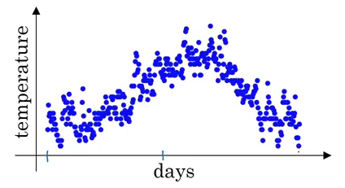
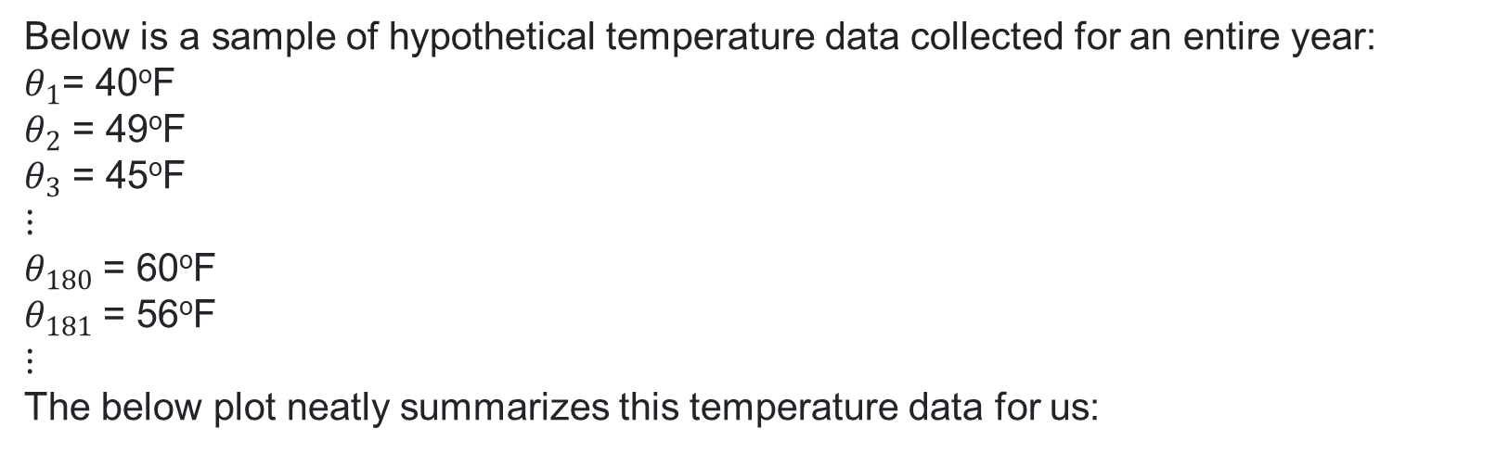
Exponentially weighted averages
Below is a sample of hypothetical temperature data collected for an entire year:
$θ_{1}$= 40ºF
$θ_{2}$ = 49ºF
$θ_{3}$ = 45ºF
$$⋮$$
$θ_{180}$ = 60ºF
$θ_{181}$ = 56ºF
$$⋮$$
The below plot neatly summarizes this temperature data for us:

Slide 23
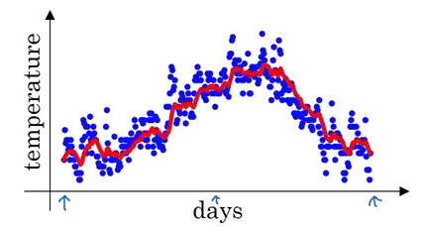
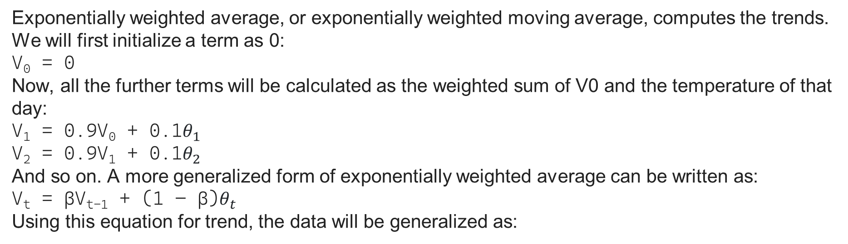
Exponentially weighted averages
Exponentially weighted average, or exponentially weighted moving average, computes the trends. We will first initialize a term as 0:
V₀ = 0
Now, all the further terms will be calculated as the weighted sum of V0 and the temperature of that day:
V₁ = 0.9V₀ + 0.1$θ_{1}$
V₂ = 0.9V₁ + 0.1$θ_{2}$
And so on. A more generalized form of exponentially weighted average can be written as:
V_{t} = βV_{t-1} + (1 – β)$θ_{t}$
Using this equation for trend, the data will be generalized as:

Slide 24
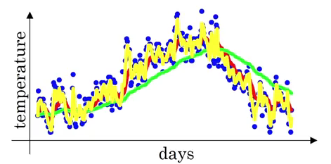
Exponentially weighted averages
The β value in this example is 0.9, which means V_{t} is an approximation of average over 1/(1-β) days, i.e., 1/(1-0.9) = 10 days temperature. Increasing the value of β will result in approximating over more days, i.e., taking the average temperature of more days. If the β value is small, i.e., we use only 1 day’s data for approximation, the predictions become much more noisy:
Here, the green line is the approximation when β = 0.98 (using 50 days) and the yellow line is when β = 0.5 (using 2 days). It can be seen that using small β results in noisy predictions.

Slide 25
Exponentially weighted averages
The choice of β depends on the nature of the data and the desired level of smoothing. By varying the value of β, one can obtain different levels of smoothing and adaptation to changes in the data. The exponentially weighted average is a widely used technique in signal processing, finance, and machine learning, where it is used in optimization algorithms that are faster than gradient descent.

Slide 26
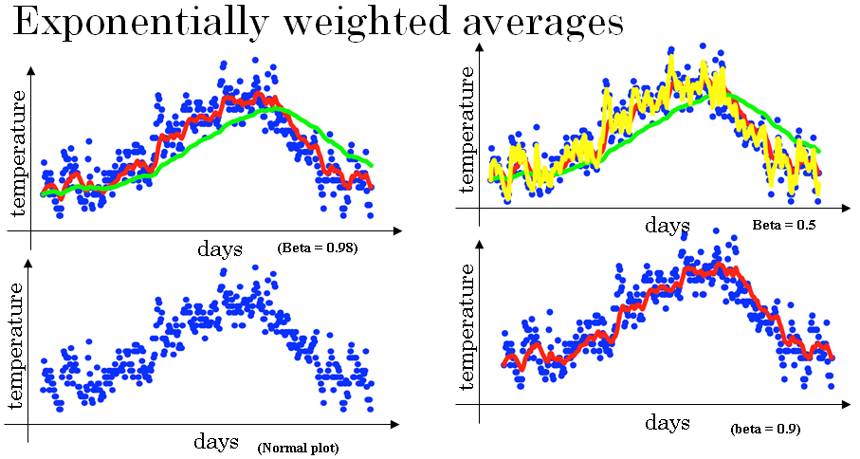

Slide 27
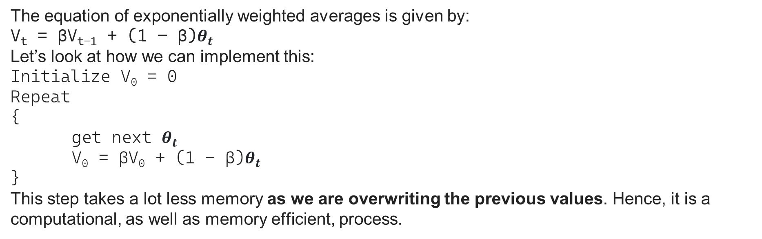
Exponentially weighted averages
The equation of exponentially weighted averages is given by:
V_{t} = βV_{t-1} + (1 – β)$θ_{t}$
Let’s look at how we can implement this:
Initialize V₀ = 0
Repeat
{
get next $θ_{t}$
V₀ = βV₀ + (1 - β)$θ_{t}$
}
This step takes a lot less memory as we are overwriting the previous values. Hence, it is a computational, as well as memory efficient, process.

Slide 28
Optimization Algorithms
Understanding exponentially weighted averages

Slide 29
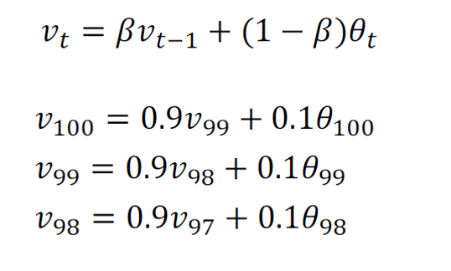
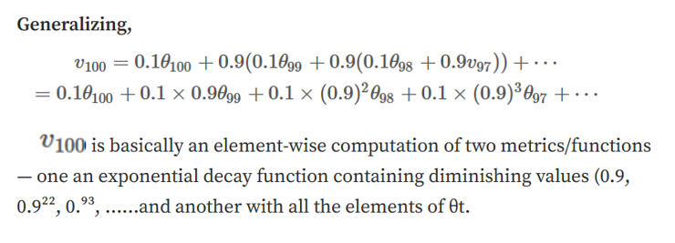
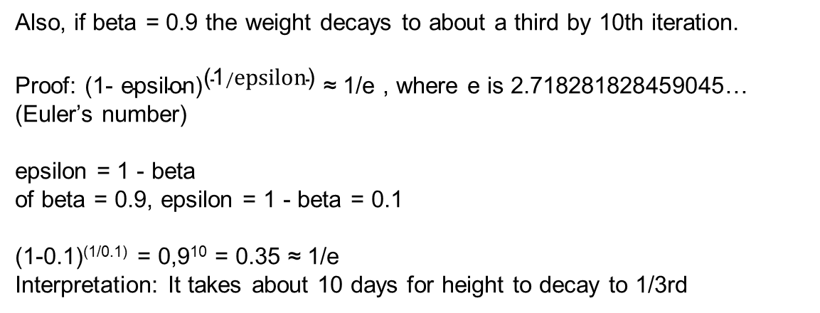
Exponentially weighted averages (EWA)
Also, if beta = 0.9 the weight decays to about a third by 10th iteration.
Proof: ${\text{(1−} \text{epsilon}\text{)}}^{\text{(1}/\text{epsilon}\text{)}}$ ≈ 1/e , where e is 2.718281828459045… (Euler’s number)
epsilon = 1 - beta
of beta = 0.9, epsilon = 1 - beta = 0.1
(1-0.1)^{(1/0.1)} = 0,9¹⁰ = 0.35 ≈ 1/e
Interpretation: It takes about 10 days for height to decay to 1/3rd

Slide 30
Exponentially weighted averages
The EWA algorithm computes a time series moving average with exponentially decaying weights, adapting faster with smaller beta and slower with larger beta.
Its efficiency lies in minimal memory usage, making it suitable for computing averages across numerous variables.
Notes:
The intuition behind the EWA algorithm is that it is like computing a moving average of the time series data but with an exponentially decaying weight for each data point. As beta gets closer to 1, the EWA algorithm focuses more on recent data and adapts more slowly to changes in the time series. Conversely, as beta gets smaller, the EWA algorithm focuses more on older data and adapts more quickly to changes in the time series.
One advantage of the EWA algorithm is that it takes up very little memory since only one row number needs to be stored in memory at any given time. This makes it an efficient and simple way to compute averages of time series data, especially when there are a large number of variables to compute averages for.

Slide 31
Optimization Algorithms
Bias correction in exponentially
weighted average

Slide 32
Bias correction in exponentially
weighted average
Exponentially weighted moving averages play a vital role in optimizing neural networks during training. They involve calculating a weighted average that prioritizes recent values while smoothing out noise
To enhance accuracy, a bias correction technique is often applied, adjusting the initialization and computation using the formula.
V₀ = 0
V_{t} = βV_{t-1} + (1-β)θ_{t}
Notes:
Exponentially weighted moving averages are a key component of several optimization algorithms used in training neural networks. The basic idea is to calculate an exponentially weighted average of a parameter by giving more weight to recent values and less weight to older values. This can be useful in smoothing noisy data and tracking trends.
However, when implementing this algorithm, there is a technical detail called bias correction that can make the computation of these averages more accurate, especially during the initial phase of learning. When implementing a moving average, we typically initialize it with V₀ equals 0, and then calculate V_{t} using the formula:
V_{t} = βV_{t-1} + (1-β)θ_{t}

Slide 33
Bias correction in exponentially
weighted average
When we calculate V_{t} using this formula, it can result in a bias towards lower values, especially during the initial phase of learning. This is because the first few values of V_{t} are calculated using a small number of θ_{t} values, which can cause the moving average to underestimate the true value of the parameter.
To correct for this bias, we can modify the estimate of V_{t} by dividing it by a correction factor, which is 1-β^{t} :
V_{t} = [βV_{t-1} + (1-β)θ_{t} ] / (1-β^{t})
This correction factor ensures that the estimate is normalized and takes into account the fact that we are using a smaller number of θ_{t} values during the initial phase of learning. By doing this, we can obtain a more accurate estimate of the parameter during the initial phase of learning.
Notes:
But when we calculate V_{t} using this formula, it can result in a bias towards lower values, especially during the initial phase of learning. This is because the first few values of V_{t} are calculated using a small number of θ_{t} values, which can cause the moving average to underestimate the true value of the parameter.
To correct for this bias, we can modify the estimate of V_{t} by dividing it by a correction factor, which is 1-β^{t} :
V_{t} = [βV_{t-1} + (1-β)θ_{t} ] / (1-β^{t})
This correction factor ensures that the estimate is normalized and takes into account the fact that we are using a smaller number of θ_{t} values during the initial phase of learning. By doing this, we can obtain a more accurate estimate of the parameter during the initial phase of learning.

Slide 34
Bias correction in exponentially
weighted average
Bias correction in machine learning isn't always applied due to computational costs, and some initial bias may be acceptable. However, when early-phase accuracy is crucial, bias correction becomes valuable.
These concepts are essential for optimizing neural network training and enhancing model accuracy and efficiency.
Notes:
In practice, bias correction is not always used in machine learning because it can be computationally expensive and most people are willing to tolerate some bias during the initial phase of learning. However, if accuracy is important during the initial phase of learning, then bias correction can be a useful tool.
Overall, exponentially weighted moving averages and bias correction are important concepts to understand in machine learning because they can be used to optimize the training of neural networks and other models. By understanding these concepts, we can better understand how to use these optimization algorithms to improve the accuracy and efficiency of our models.

Slide 35
Optimization Algorithms
Gradient descent with momentum

Slide 36

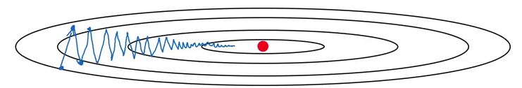
Gradient descent with momentum
An algorithm called momentum, or gradient descent with momentum that almost always works faster than the standard gradient descent algorithm.
The underlying idea of gradient descent with momentum is to calculate the exponential weighted average of gradients and use them to update weights. Suppose we have a cost function whose contours look like this:
The red dot is the global minima, and we want to reach that point. Using gradient descent, the updates will look like:
Notes:
An algorithm called momentum, or gradient descent with momentum that almost always works faster than the standard gradient descent algorithm.
The basic idea is to compute an exponentially weighted average of gradients and use that to update weights instead of using the derivative directly.
Momentum add the moving averages equation to the derivative calculations adding the impact of previous iterations
The goal is to prevent oscillations and enable faster learning in the horizontal direction while slowing down the oscillations in the vertical direction.
Another way of viewing this problem is that on the vertical axis you want your learning to be a bit slower, because you don't want those oscillations. But on the horizontal axis, you want faster learning. because you want it to aggressively move from left to right, toward that minimum, toward that red dot. This can be achieved with gradient descent with momentum.

Slide 37
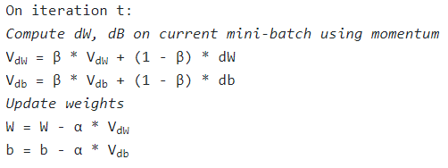
Gradient descent with momentum
One more way could be to use a larger learning rate. But that could result in large upgrade steps, and we might not reach global minima. Additionally, too small a learning rate makes the gradient descent slower. We want a slower learning in the vertical direction and a faster learning in the horizontal direction which will help us to reach the global minima much faster.
Let’s see how we can achieve it using momentum:
Notes:
An algorithm called momentum, or gradient descent with momentum that almost always works faster than the standard gradient descent algorithm.
The basic idea is to compute an exponentially weighted average of gradients and use that to update weights instead of using the derivative directly.
Momentum add the moving averages equation to the derivative calculations adding the impact of previous iterations
The goal is to prevent oscillations and enable faster learning in the horizontal direction while slowing down the oscillations in the vertical direction.
Another way of viewing this problem is that on the vertical axis you want your learning to be a bit slower, because you don't want those oscillations. But on the horizontal axis, you want faster learning. because you want it to aggressively move from left to right, toward that minimum, toward that red dot. This can be achieved with gradient descent with momentum.

Slide 38
Gradient descent with momentum
The hyperparameters α and β in the given equation control momentum and friction, respectively, in the gradient descent algorithm. The terms dW and db contribute momentum, while V_{dw} and V_{db} represent velocity. β acts as friction, preventing excessive acceleration.
The algorithm ensures that steps are smaller oscillations in the vertical direction, emphasizing quick movement horizontally.
The terms (1−β) resemble acceleration, and β resembles velocity on a specific point.
While bias correction can be applied, its impact diminishes quickly, making it less practical.
β becomes a new hyperparameter influencing the learning rate α.
Notes:
Here, we have two hyperparameters, i.e., α and β. The role of dW and db in the above equation is to provide momentum, V_{dw} and V_{db} provides velocity, and β acts as friction and prevents speeding over the limit. Consider a ball rolling down – V_{dw} and V_{db} provide velocity to that ball and make it move faster. We do not want our ball to speed up so much that it misses the global minima, and hence β acts as friction.
With this algorithm, with a few iterations you find that the gradient descent with momentum ends up eventually just taking steps that are much smaller oscillations in the vertical direction, but are more directed to just moving quickly in the horizontal direction.
The (1−β) can be seen as acceleration and the β as the velocity on that specific point
The bias correction can be implemented but as with just few steps it’ll correct itself it makes not much sense to many to implement it
With these equations β becomes a new hyperparameter which directly interfere on the learning rate α.

Slide 39
Optimization Algorithms
RMSprop

Slide 40
RMSprop (Root Means Square Propagation)
RMSprop is an optimization algorithm that can speed up gradient descent. It works by keeping an exponentially weighted average of the squares of the derivatives for each parameter. This average is then used to adjust the learning rate for each parameter during the update step.
RMSprop is particularly effective at reducing oscillations in the vertical direction, where the function is sloped more steeply. This is achieved by dividing the update for each parameter by a larger number in the vertical direction than in the horizontal direction.

Slide 41
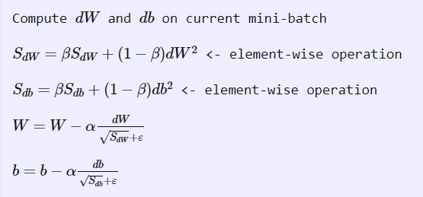
RMSprop
Intuition is that in dimensions where you’re getting these oscillations, you end up computing a larger sum. A weighted average for these squares and derivatives, and so you end up dumping out the directions in which there are these oscillations.
The ε is present in the denominator to avoid division by 0

Slide 42
RMSprop
In practice, RMSprop is used in high-dimensional parameter spaces, where the oscillations may be present in a subset of parameters. By taking the squared derivatives of these parameters, RMSprop can dampen the oscillations and speed up the learning process.
To ensure numerical stability, a very small epsilon value is added to the denominator to prevent division by zero or very small numbers.
RMSprop was first introduced in a Coursera course taught by Jeff Hinton and has since become a widely used optimization algorithm in deep learning.

Slide 43
Optimization Algorithms
Adam optimization algorithm

Slide 44
Adam optimization algorithm
The field of deep learning has seen many optimization algorithms proposed over time, but few have been shown to work well across a wide range of neural networks. Gradient descent with momentum has been a popular and effective algorithm, and RMSprop and Adam have been two algorithms that have also been shown to work well across a wide range of deep learning architectures.
Adam (stands for Adaptive Moment Estimation) is an optimization algorithm that combines the effect of gradient descent with momentum and gradient descent with RMSprop. The algorithm has several hyperparameters, including the learning rate α, β₁, β₂, and epsilon. The default values for β₁ and β₂ are 0.9 and 0.999, respectively, and the recommended value for ϵ is 10⁻⁸.

Slide 45
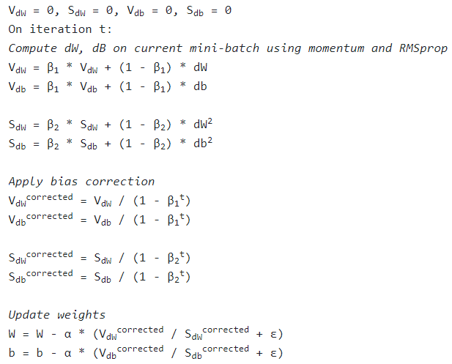
Adam optimization algorithm

Slide 46
Hyperparameters
There are a range of hyperparameters used in Adam and some of the common ones are:
Learning rate α: needs to be tuned
Momentum term β1: common choice is 0.9
RMSprop term β2: common choice is 0.999
ε: 10⁻⁸
Adam helps to train a neural network model much more quickly than the techniques we have seen earlier.

Slide 47
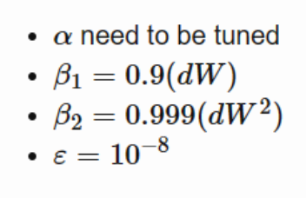
Hyperparameters
Adam Cotes

Slide 48
Adam optimization algorithm
β₁ is used to compute the mean of the derivatives (called the first moment) and β₂ is used to compute the exponentially weighted average of the squares (called the second moment). The bias correction is also implemented in Adam to improve numerical stability.
Hyperparameter tuning is an important step in optimizing the performance of deep learning models. In practice, it is common to use default values for β₁, β₂, and ϵ, and to tune the learning rate α by trying a range of values to see what works best.

Slide 49
Optimization Algorithms
Learning rate decay

Slide 50
Learning rate decay
Learning rate decay is a technique used to gradually reduce the learning rate α over time during the training process of a neural network.
The intuition behind this technique is that as learning approaches convergence, having a slower learning rate allows for smaller and more precise steps towards the minimum instead of oscillating around it.
Initially, when the learning rate is not very small, training will be faster. If we slowly reduce the learning rate, there is a higher chance of coming close to the global minima.
Learning rate decay can be given as:
α = [1 / (1 + decay_rate * epoch_number)] * α₀
The decay rate becomes another hyperparameter that you may need to tune. There are several other ways to implement learning rate decay, such as exponential decay or discrete staircase.

Slide 51
Learning rate decay
Let’s understand it with an example. Consider:
α0 = 0.2
decay_rate = 1
α₁ = [1/(1+1)]*0.2 = 0.1
α₂ = [1/(1+2)]*0.2 = 0.067
α₃ = 0.05
α₄ = 0.04

Slide 52
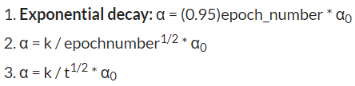
Learning rate decay
This is how, after each epoch, there is a decay in the learning rate which helps us reach the global minima much more quickly. There are a few more learning rate decay methods:
Here, t is the mini-batch number.

Slide 53
Learning rate decay
While learning rate decay isn't always essential and should be a secondary consideration among hyperparameters, setting a well-tuned fixed value for Alpha can significantly impact training. Learning rate decay may aid training speed in certain scenarios.
In neural network training, optimization algorithms strive to find a global minimum but may encounter challenges like local optima or saddle points. Recognizing these optimization issues enhances intuition about the training process.
Notes:
It's essential to note that learning rate decay is not always necessary and should be considered lower down on the list of hyperparameters to try. Instead, setting a fixed value for Alpha and tuning it well can have a significant impact on the training process. However, learning rate decay can help speed up training in some cases.
Additionally, in the training process of a neural network, optimization algorithms aim to find a global minimum, but they can get stuck in local optima or saddle points, which are points where the gradient is close to zero in several dimensions, making it challenging to continue the descent. Understanding these types of optimization problems can help develop better intuitions about the training process of neural networks.

Slide 54
Optimization Algorithms
The problem of local optima

Slide 55
The problem of local optima
In the early days of deep learning, people used to worry a lot about the optimization algorithm getting stuck in bad local optima. However, as the theory of deep learning has advanced, our understanding of local optima has also changed.
It turns out that most points of zero gradient in a cost function are not local optima but saddle points. In a very high-dimensional space, for a point to be a local optima, all directions must look like a convex light function or a concave light function, which is very unlikely.

Slide 56
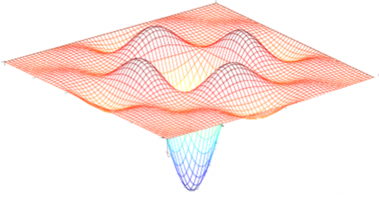
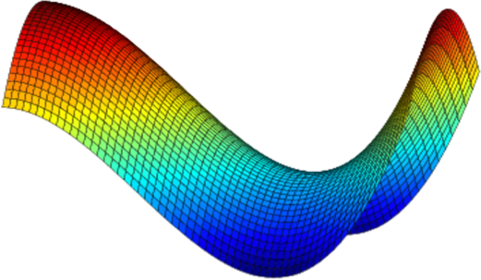
Local optima in neural networks

Slide 57
The problem of local optima
Saddle points, where the gradient is zero in various directions, and plateaus, where the derivative remains near zero, are common challenges in optimization. These hinder learning, especially on plateaus, causing slow convergence.
Algorithms like momentum, RMSProp, or Adam are beneficial in such scenarios. Due to the high-dimensional nature of neural network optimization, traditional intuition from low-dimensional spaces doesn't directly apply, and our understanding is still evolving.
Notes:
Instead, you're much more likely to encounter saddle points where the gradient is zero, and some directions have the curve bending up while others bend down. Plateaus are a bigger problem because they can slow down learning. Plateaus are regions where the derivative is close to zero for a long time, and gradient descent can take a long time to slowly find its way off the plateau.
Algorithms like momentum, RMSProp, or Adam can help your learning algorithm in these scenarios. In general, because neural networks are solving optimization problems over such high-dimensional spaces, our intuition about low-dimensional spaces does not transfer to these spaces, and our understanding of them is still evolving.

Slide 58
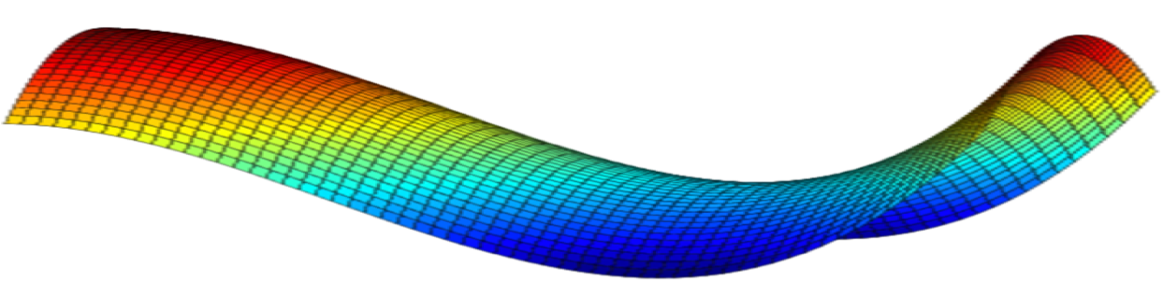


Problem of plateaus
Unlikely to get stuck in a bad local optima
Plateaus can make learning slow

Slide 59
Summarization
Mini-batch gradient descent divides training data into mini-batches for efficient updates.
Exponentially weighted averages smooth noisy data by assigning more weight to recent observations.
Bias correction improves the accuracy of early moving averages.
Gradient descent with momentum adds a fraction of the previous update to the current gradient, aiding optimization in flatter regions.
RMSprop adjusts learning rates for each parameter to handle varying gradients.
The Adam optimization algorithm combines RMSprop and momentum for efficient and adaptive updates.
Learning rate decay reduces the learning rate over time for refined updates.
Local optima, suboptimal solutions during optimization, are addressed by modern techniques like stochastic gradient descent.
Understanding these topics is crucial for effective neural network training and optimization.
Notes:
Mini-Batch Gradient Descent:
- A variant of gradient descent where training data is divided into mini-batches, and parameter updates are performed after each mini-batch. Balances efficiency and convergence.
Understanding Mini-Batch Gradient Descent:
- Explains how mini-batch gradient descent combines benefits of batch and stochastic gradient descent, providing faster convergence and reduced noise in updates.
Exponentially Weighted Averages:
- Technique to smooth noisy data by calculating the weighted average of past values. Useful for tracking trends and variations over time.
Understanding Exponentially Weighted Averages:
- Describes how exponentially weighted averages assign more weight to recent observations and less to older ones, resulting in a moving average that captures trends.
Bias Correction in Exponentially Weighted Average:
- Addresses the initial bias of exponentially weighted averages by dividing by a correction term. Helps improve the accuracy of the early moving averages.
Gradient Descent with Momentum:
- Momentum enhances gradient descent by adding a fraction of the previous update to the current gradient, helping the optimization process by navigating through flatter regions.
Root Mean Square Propagation (RMSprop):
- An optimization algorithm that adjusts learning rates for each parameter to handle varying gradients effectively.
Adam Optimization Algorithm:
- An optimization algorithm combining the benefits of RMSprop and momentum, providing efficient and adaptive parameter updates.
Learning Rate Decay:
- Learning rate decay involves reducing the learning rate over time to achieve more refined parameter updates as training progresses.
The Problem of Local Optima:
- The issue of getting stuck in suboptimal solutions (local optima) during optimization. Modern optimization techniques like stochastic gradient descent help escape local optima.
- Understanding these topics is crucial for effectively training neural networks and optimizing t heir performance during the learning process.

